Slide 1
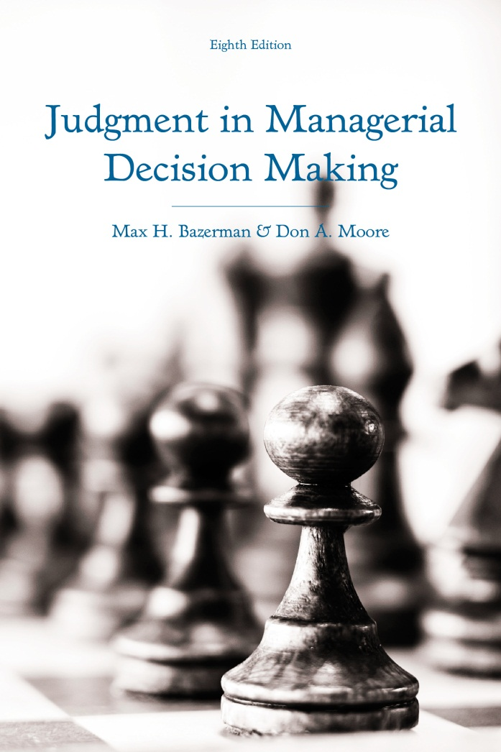
Judgment in Managerial Decision Making 8e
Chapter 8
Fairness and Ethics in Decision Making
Copyright 2013 John Wiley & Sons

Slide 2
Accepting a Job Offer
You are graduating from a good MBA program. Subsequent to your discussions with a number of ﬁrms, one of your preferred companies makes you an offer of $110,000 a year, stressing that the amount is not negotiable. You like the people. You like the job. You like the location. However, you ﬁnd out that the same company is offering $120,000 to some graduating MBAs from similar-quality schools.
Will you accept the offer?
Notes:
- Consider the following scenario about a hypothetical job offer.
- Most people are bothered by the fact that they receive less than others even though they may be happy with the job offer without knowing about the salaries of others.

Slide 3
Price Increases
Hurricane Katrina hits southern Louisiana, leaving many people homeless. For commodities such as building materials, demand is up and supply is down. This is a condi­tion that leads economists to predict an increase in prices. In fact, in the aftermath of the hurricane, a small building-supply company more than doubles its prices on many items that are in high demand, such as lumber.
Are the price increases ethical?
Are they rational?
Notes:
Now, consider this scenario about price increases in response to an increase in demand caused by a natural disaster.
Though it is rational to increase prices in response to increases in demand, people are outraged by what they perceive to be an unfair price increase that takes advantage of others’ misfortune.
This problem and the prior problem illustrate that perceptions of fairness and ethics often cause decisions to deviate from what would be predicted by economic theory.
In order to better predict the behavior of others, it is crucial to understand how fairness and ethics come into play.

Slide 4
Supply and Demand
A hardware store has been selling snow shovels for $15. The morning after a large snowstorm, the store raises the price to $20.
Notes:
Consider the following scenario about a store increasing the price of snow shovels after an increase in demand brought about by a snowstorm.
From an economic perspective, it is completely rational to increase shovel prices in response to the snowstorm.
Despite the rationality of raising prices, 82% of people view a price increase as unfair in this scenario.
However, if this problem were reversed so that you took the perspective of the store owner, it may not necessarily seem rational to raise prices. Because price increases infuriate customers, an increase in prices may result in the loss of future customers. Thus, it could be completely rational to keep prices low despite what supply-and-demand considerations would suggest.

Slide 5
Framing and Fairness
A company is making a small proﬁt. It is located in a commu­nity experiencing a recession with substantial unemployment but no inﬂa­tion. Many workers are anxious to work at the company. The company decides to decrease wages and salaries 7 percent this year.
A company is making a small proﬁt. It is located in a commu­nity experiencing a recession with substantial unemployment and inﬂation of 12 percent. Many workers are anxious to work at the company. The com­pany decides to increase wages and salaries 5 percent this year.
Notes:
Perceptions of fairness are also susceptible to framing effects.
Consider the two scenarios here.
Most people perceive a decrease in wages as in the one to the left to be unfair.
However, when real wages are decreased to the same extent despite an increase in nominal wages, people perceive a cut in real wages to be relatively fair.
Overall, it seems that we consider decreases in nominal wages to be unfair regardless of the effect on real wages.

Slide 6
Framing and Fairness
A shortage has developed for a popular model of automobile, and customers must now wait two months for delivery. A dealer has been selling these cars at list price. Now the dealer prices this model at $200 above list price.
A shortage has developed for a popular model of automobile, and customers must now wait two months for delivery. A dealer has been selling these cars at a discount of $200 below list price. Now the dealer prices this model at list price.
Notes:
As with framing wages in real terms or nominal terms, framing price increases as deviations from list price versus discount price can impact perceptions of fairness.
In the scenario to the left, people perceive a increase in price from list price to be unfair.
However, in the scenario to the right, people are much less likely to consider an identical increase in price from discount price to list price to be unfair.
Overall, it appears that perceptions of fairness are very sensitive to framing.
Thus, even though actions may be logical from a supply and demand perspective, they become illogical when they are framed as a deviation from the status quo that harms consumers, as people perceive such actions to be unfair.

Slide 7
When We Resist “Unfair” Ultimatums
People often reject profit opportunities
Fairness considered in offers
Fair dictators?
  Dictators often allocate to others
  Pay-what-you-want pricing
The persistent desire for fairness
  Based on emotions
  Cross-cultural
  Fairness in primates
Notes:
In what is known as the ultimatum game paradigm, people have an opportunity to split a pie of money between themselves and another player as they see fit. However, if the other player rejects the offer, no player wins anything.
If both players were perfectly rational and did not incorporate fairness considerations into their decisions, then those making offers would always offer $1 while keeping the rest and those receiving offers would always accept the offer since winning $1 is better than $0.
However, people often reject offers where they receive less than 20% of the pie because they perceive the offers to be unfair. Essentially, they derive more utility from denying the proposer’s allocation than they would have if the proposed allocation went through.
It also is clear that proposers account for fairness when making offers, as they typically offer a 50/50 split even though they could probably offer less and still make a profit.
There is also another version of the ultimatum game known as the dictator game. In this game, “dictators” can offer any sum of the pie of money that they like to another player and the other player must accept their offer regardless of how they feel.
Despite the fact that they have complete outcome control, dictators typically do not take all of the money available in the pie despite having the option to do so.
A real-world analogue to a dictator game is pay-what-you-want pricing. The concept behind pay-what-you-want pricing is that consumers can purchase a product for any product that they like, including $0.
Though people pay less for products under a pay-what-you-want format than under a more traditional format, many more people purchase products and in some cases, profits can be higher under a pay-what-you-want scheme than under a more traditional scheme.
People rarely pay nothing for products even though they have the opportunity, which suggests that fairness is an important consideration to them.
Evidence from the laboratory suggests that our persistent desire for fairness has a biological basis.
We tend to activate parts of the brain associated with negative emotion when considering unfair offers.
Cross-cultural studies suggest that fairness is an important consideration in every society that has been tested, though its strength may vary across cultures.
Even monkeys tend to respond to unfairness by refusing to work for rewards.

Slide 8
When We are Concerned about the Outcomes of Others
Pay differentials
  Pay equity and product quality
  Pay equity in MLB teams
  CEO pay differential and performance
Others’ outcomes as reference points
  Acceptability ratings versus choice behavior
  Joint versus separate evaluation
Notes:
Pay differentials play an important role in dictating organization-level outcomes.
Companies with more pay equity tend to produce better products than ones with pay inequity.
Major league baseball teams with more pay equity tend to perform better than those with pay inequity.
The gap between CEO pay and the pay of the average executive is negatively correlated with performance.
Pay differentials have important consequences because we use others’ outcomes as reference points to help us determine the acceptability of our own outcomes.
Though we tend to consider pay inequity to be unacceptable even when it means we would accept a lower salary that puts us on par with the salary of others, our actual choice behavior tends to favor outcomes that are more favorable to ourselves regardless of how we feel about the outcome.
Our perceptions of fairness are also dictated by whether we evaluate options jointly or separately.
When evaluating outcomes separately, we often rely on others’ outcomes as a reference point for what we should consider to be a fair outcome for ourselves.
However, when evaluating outcomes jointly, we often adopt a more rational mindset and favor the most favorable outcomes while ignoring the outcomes of others.

Slide 9
Perverse Consequences of Equality Norms
You visit a car dealer and go on a test drive. You return to the salesperson’s cubicle in the showroom, ready to do a deal. The car has a list price of $18,000. After a short discussion, you offer $15,500. The salesperson counters with $17,600, you counter with $16,000, he counters with $17,200, you counter with $16,400, and he reduces his price to $16,800. You act as if you will not make another move and threaten to visit another dealership. The salesperson then says earnestly, “You look like a nice person, and I can see that you really like the car. My main concern is that you get the car that you want. I assume that you are a reasonable person, and I want to be reasonable. How about if we split the difference—$16,600?”
Notes:
Take a moment to read the following scenario.
Think about what you would do here.
Most of us would quickly accept the offer because the salesperson has split the difference.
This seems to be fair to most people, but it is merely an artifact of the situational framing and the prior offers that were made.
In the absence of information about the prior offers made, people may not perceive an price of $16,600 to be fair. This reflects the arbitrariness of fairness perceptions.

Slide 10
Why do Fairness Judgments Matter?
People punish unfair behaviors
  Third parties in dictator games
  Satisfaction from punishing unfair behavior
Accounting for others’ fairness perceptions
Notes:
Fairness is so important that people go out of their way to punish unfair behaviors.
In modified dictator games, people are willing to incur a loss from their own earnings in order to punish unfair dictators.
Punishment of cheaters are predicted by activity in a region of the brain associated with satisfaction, so it appears that people derive utility from punishing unfair behaviors, even when it is associated with an economic loss.
Though it is not necessarily clear whether punishing others is in an individual’s best interest, it is clear that decision-makers would be well-advised to consider the perceptions of others before making decisions involving fairness considerations. Even though fair allocations to others may not be in an individual’s best short-term financial interest, long-term interests may be best served by making decisions that will be perceived favorably by others.

Slide 11
Bounded Ethicality
Overclaiming credit
In-group favoritism
Implicit attitudes
Indirectly unethical behavior
Pseudo-sacred values
Conflicts of interest
Notes:
Bounded ethicality is unethical behavior that occurs outside of our conscious awareness. There are seven forms of bounded ethicality that we will discuss:
In-group favoritism, or the tendency to favor in-group members over out-group members.
Implicit attitudes, or unconscious attitudes that we hold about others.
Indirectly unethical behavior, or behavior that harms others indirectly.
Values that we consider to be sacred.
Conflicts of interest that impact our behavior despite our best efforts to not be biased.

Slide 12
Overclaiming Credit
Overestimating our contributions
  Spouses and household work
  Joint ventures
Reducing overclaiming by considering others
Notes:
One thing that we commonly do is overclaim the amount of credit that we deserve on a task performed with others.
This is often reflected in adding estimates of the percentage of tasks that people say they are responsible for. Often, these tasks sum up to a total greater than 100%, which is greater than the maximum amount of responsibility and greater than 50%, which would indicate an even split of tasks.
People overestimate the percentage of household chores that they are responsible for relative to their spouse.
In joint ventures, each party is reluctant to contribute its best resources into a project unless they are sure that the other party will also be fully invested. Combined with the tendency to overclaim credit, each party often feels justified in reducing its contribution to the joint venture, which breeds a mutual perception that the other party is unfair.
One way to reduce (but not eliminate) the tendency to overclaim credit is to directly ask people to consider both their own contributions and the contributions of others.

Slide 13
In-Group Favoritism
Favoring similar others
Indirect discrimination
  Positive characteristics
  Social norm enforcement
Consequences
  Loans
  Legacy admissions
Notes:
A vast line of literature exists suggesting that we tend to perform favors for similar others.
This tendency to help out people who are like us seems communal and harmless, but it has the unintended consequence of indirect discrimination.
People are less likely to associate positive characteristics with out-group members than with in-group members.
People are less likely to punish unfair behavior when it is directed at demographically different others than they are for demographically different others.
This tendency to indirectly discriminate against out-group members in favor of in-group members has important consequences.
African-Americans are more likely than Caucasians to have their loan applications denied when controlling for a variety of factors. One reason for this may be that predominately white loan officers are more likely to approve loans to unqualified whites who are similar to themselves than to equally unqualified blacks who are different from themselves.
Many schools admit legacies whose parents attended the university. A consequence of this practice is that less qualified applicants from privileged households with Ivy-League educated parents are more likely to be admitted to top universities than even more qualified applicants from less privileged households who lack the connections necessary to be admitted to top institutions.

Slide 14
Implicit Attitudes
Unconscious prejudice
The IAT
Implicit attitudes predict actual behavior
  Females and social skills
  Nonverbal behaviors
  Spontaneous versus deliberative behaviors
Lowering prejudice in society
Notes:
Overall, there is a plethora of evidence suggesting that we hold implicit attitudes favoring some demographic groups over others.
We are more likely to respond to aggression after seeing a black face than after seeing a white face.
The automatic activation of stereotypes tends to make whites uncomfortable in interracial interactions.
We require conscious effort that is cognitively taxing in order to suppress our negative racial stereotypes.
The IAT is one tool commonly used to assess implicit attitudes.
It involves categorizing items as quickly as possible. For example, a black face may appear and then you may subsequently have to categorize words by indicating whether they are “good” or “bad”.
For example, the more quickly you accurately associate “good” words to white faces relative to black faces, the greater the extent you are considered to have pro-white implicit attitudes.
Though the IAT seems like a strange way to predict actual behavior, it actually has been demonstrated to predict observable behaviors.
People who tend to associate women with communal traits implicitly tend to consider ambitious women as lacking social skills.
Implicit attitudes are associated with nonverbal behaviors towards different groups of people.
Implicit attitudes tend to predict our spontaneous behaviors while they do not predict more deliberative behaviors very well.
One way that we may reduce our implicit biases that favor particular social groups is by lowering prejudice in society as a whole. For example, one study found that after Barack Obama’s election, people became less prejudiced towards blacks than they were before his election. A reason for this may be that he provides a salient positive exemplar of African-Americans.

Slide 15
Prescription Drug Prices
Imagine that a major pharmaceutical company is the sole marketer of a particular cancer drug. The drug is not profitable, due to high fixed costs and a small market size, yet the patients who do buy the drug depend on it for their survival. The pharmaceutical company currently produces the drug at a total cost of $5/pill and only sells it for $3/pill. A price increase is unlikely to decrease use of the drug, but will impose significant hardship on many users.
How ethical would it be for the company to raise the price of the drug from $3/pill to $9/pill?
Notes:
Take a moment to consider this scenario.
Most people consider it unethical for the company to raise its prices and impose hardship on those who depend on it.

Slide 16
Prescription Drug Prices
Now imagine that, instead of raising the price, the company sold the rights to produce the drug to a smaller, lesser-known pharmaceutical company. At a meeting between the two companies, a young executive from the smaller firm says: “Since our reputation is not as critical as yours, and we are not in the public’s eye, we can raise the price five fold to $15/pill.”
Would selling the manufacturing and marketing rights to the other firm be more or less ethical?
Notes:
Now, consider this adapted version of the scenario.
In this case, the company is not directly raising the price, but is doing it indirectly by selling production rights to a relatively unknown company.
Additionally, the price will ultimately raise to $7 higher that in the previous scenario.
Despite the higher price, due to the indirect nature of the price increase, people believe that this outcome is more fair than the previous outcome.
However, when people are asked to evaluate this scenario and the prior scenario jointly, they tend to believe that this outcome is more unfair than the previous outcome.

Slide 17
Indirectly Unethical Behavior
Impression management
Protection of self-perceptions
Notes:
As suggested by the prior examples, one important aspect of indirect behavior is that it allows people to manage the impressions that others form of them. A study finding that people are more likely to sacrifice $1 than to allocate the entire pie of money to themselves in a dictator game so that they can prevent their counterpart from knowing that they had received an unequal allocation.
People also go through great lengths to protect their perception of themselves as ethical individuals.
One study found that people will keep themselves ignorant about the economic outcomes of others when they have the opportunity to select an option that is in their economic best interest. This probably allowed participants to feel that any potential harm to others was indirectly caused by them since they did not have a conscious awareness of others’ payoffs.

Slide 18
When Values Seem Sacred
Sacred versus secular tradeoffs
  Paying for sex
  Paying for organs
  Paying for babies
Emotions often precede assessments
Notes:
We frequently face tradeoffs between sacred issues and secular issues. Typically ,these involve considerations of whether we think it is acceptable to trade a secular item such as money for compromising a sacredly held value.
The exchange of money for sex is one example of violating a sacredly held value (taboos against causal sex) in exchange for money.
The sale of organs is another example, as it involves violating the view that people are entitled to their organs in exchange for money.
In the case of exchanging babies for money, the sacred value of raising your own child is violated.
The mere consideration of sacred-secular tradeoffs often causes us to distance ourselves from the idea that we had even considered the possibility of violating a sacredly held value by either expressing moral outrage or moral cleansing (i.e., volunteering time to promote morally acceptable behaviors).
Evidence is starting to arise that our need to uphold moral values is unconscious and rationalized in a post-hoc fashion. For example, in a study asking people to sign an explicitly meaningless paper asking them to sell their soul in exchange for $2, they rarely did so. When asked to rationalize their decisions, people had difficulty articulating why they did not sign the paper.

Slide 19
The Psychology of Conflict of Interest
Conflicts of interest bias decisions
Disclosure increases bias
Motivated blindness
  Financial analyst recommendations
  Major League Baseball and steroids
  Molestation in the Catholic Church
  Credit-rating agencies
Addressing conflicts of interest
  Eliminate them
  Disclosure is not the solution
  Recognize your susceptibility to bias
Notes:
A long line of evidence suggests that conflict of interest between our self-interest and the interest of others leads to biased decision-making despite the best intentions of people not to be biased by their self-interest.
One proposed solution to resolving conflicts of interest is to disclose these conflicts. However, research actually suggests that this may not be an effective strategy since the evidence suggests that people actually behave more unethically after disclosing a conflict of interest.
In addition to being susceptible to bias resulting from conflicts of interest, we are also prone to being biased by motivated blindness, or a failure to notice information that challenges our self-interest. Some people who regularly face this issue:
Financial analysts often provide recommendations about companies that hire them. Because it is arguably in the best interest of analysts to continue receiving income from some of the companies that they evaluate by providing those companies with “buy” recommendations, financial analysts are typically motivated to avoid evidence suggesting that a “buy” recommendation is unwarranted for one of their clients.
The Major League Baseball scandal with steroids is another example of motivated blindness. Owners and league officials failed to notice rampant steroid use in the game and one reason may be that they were so preoccupied with the financial success experienced by the league, they failed to notice an epidemic of steroid use due to fear of fans reacting negatively to this news.
One Cardinal in the Catholic Church saw signs of child sexual abuse by priests, but he was so committed to the idea that abusive priests could be reformed and so motivated to not let the Church’s image be tarnished that he failed to take action against abusive priests.
Credit-rating agencies also face a fundamental conflict of interest. Like financial analysts, credit-rating agencies are typically paid by clients to rate their assets. This can lead to biased decisions in favor of clients.
Because motivated reasoning and motivated blindness are largely unconscious, it is difficult to address these issues.
One solution is to eliminate conflicts of interest.
Another is to disclose one’s conflicts of interest with others. However, research suggests that this strategy may not work.
The best thing one may be able to do is recognize his or her susceptibility to bias. By first acknowledging that one may be biased, he or she can then be more vigilant against conflicts of interest and motivated reasoning.

